Slide 1
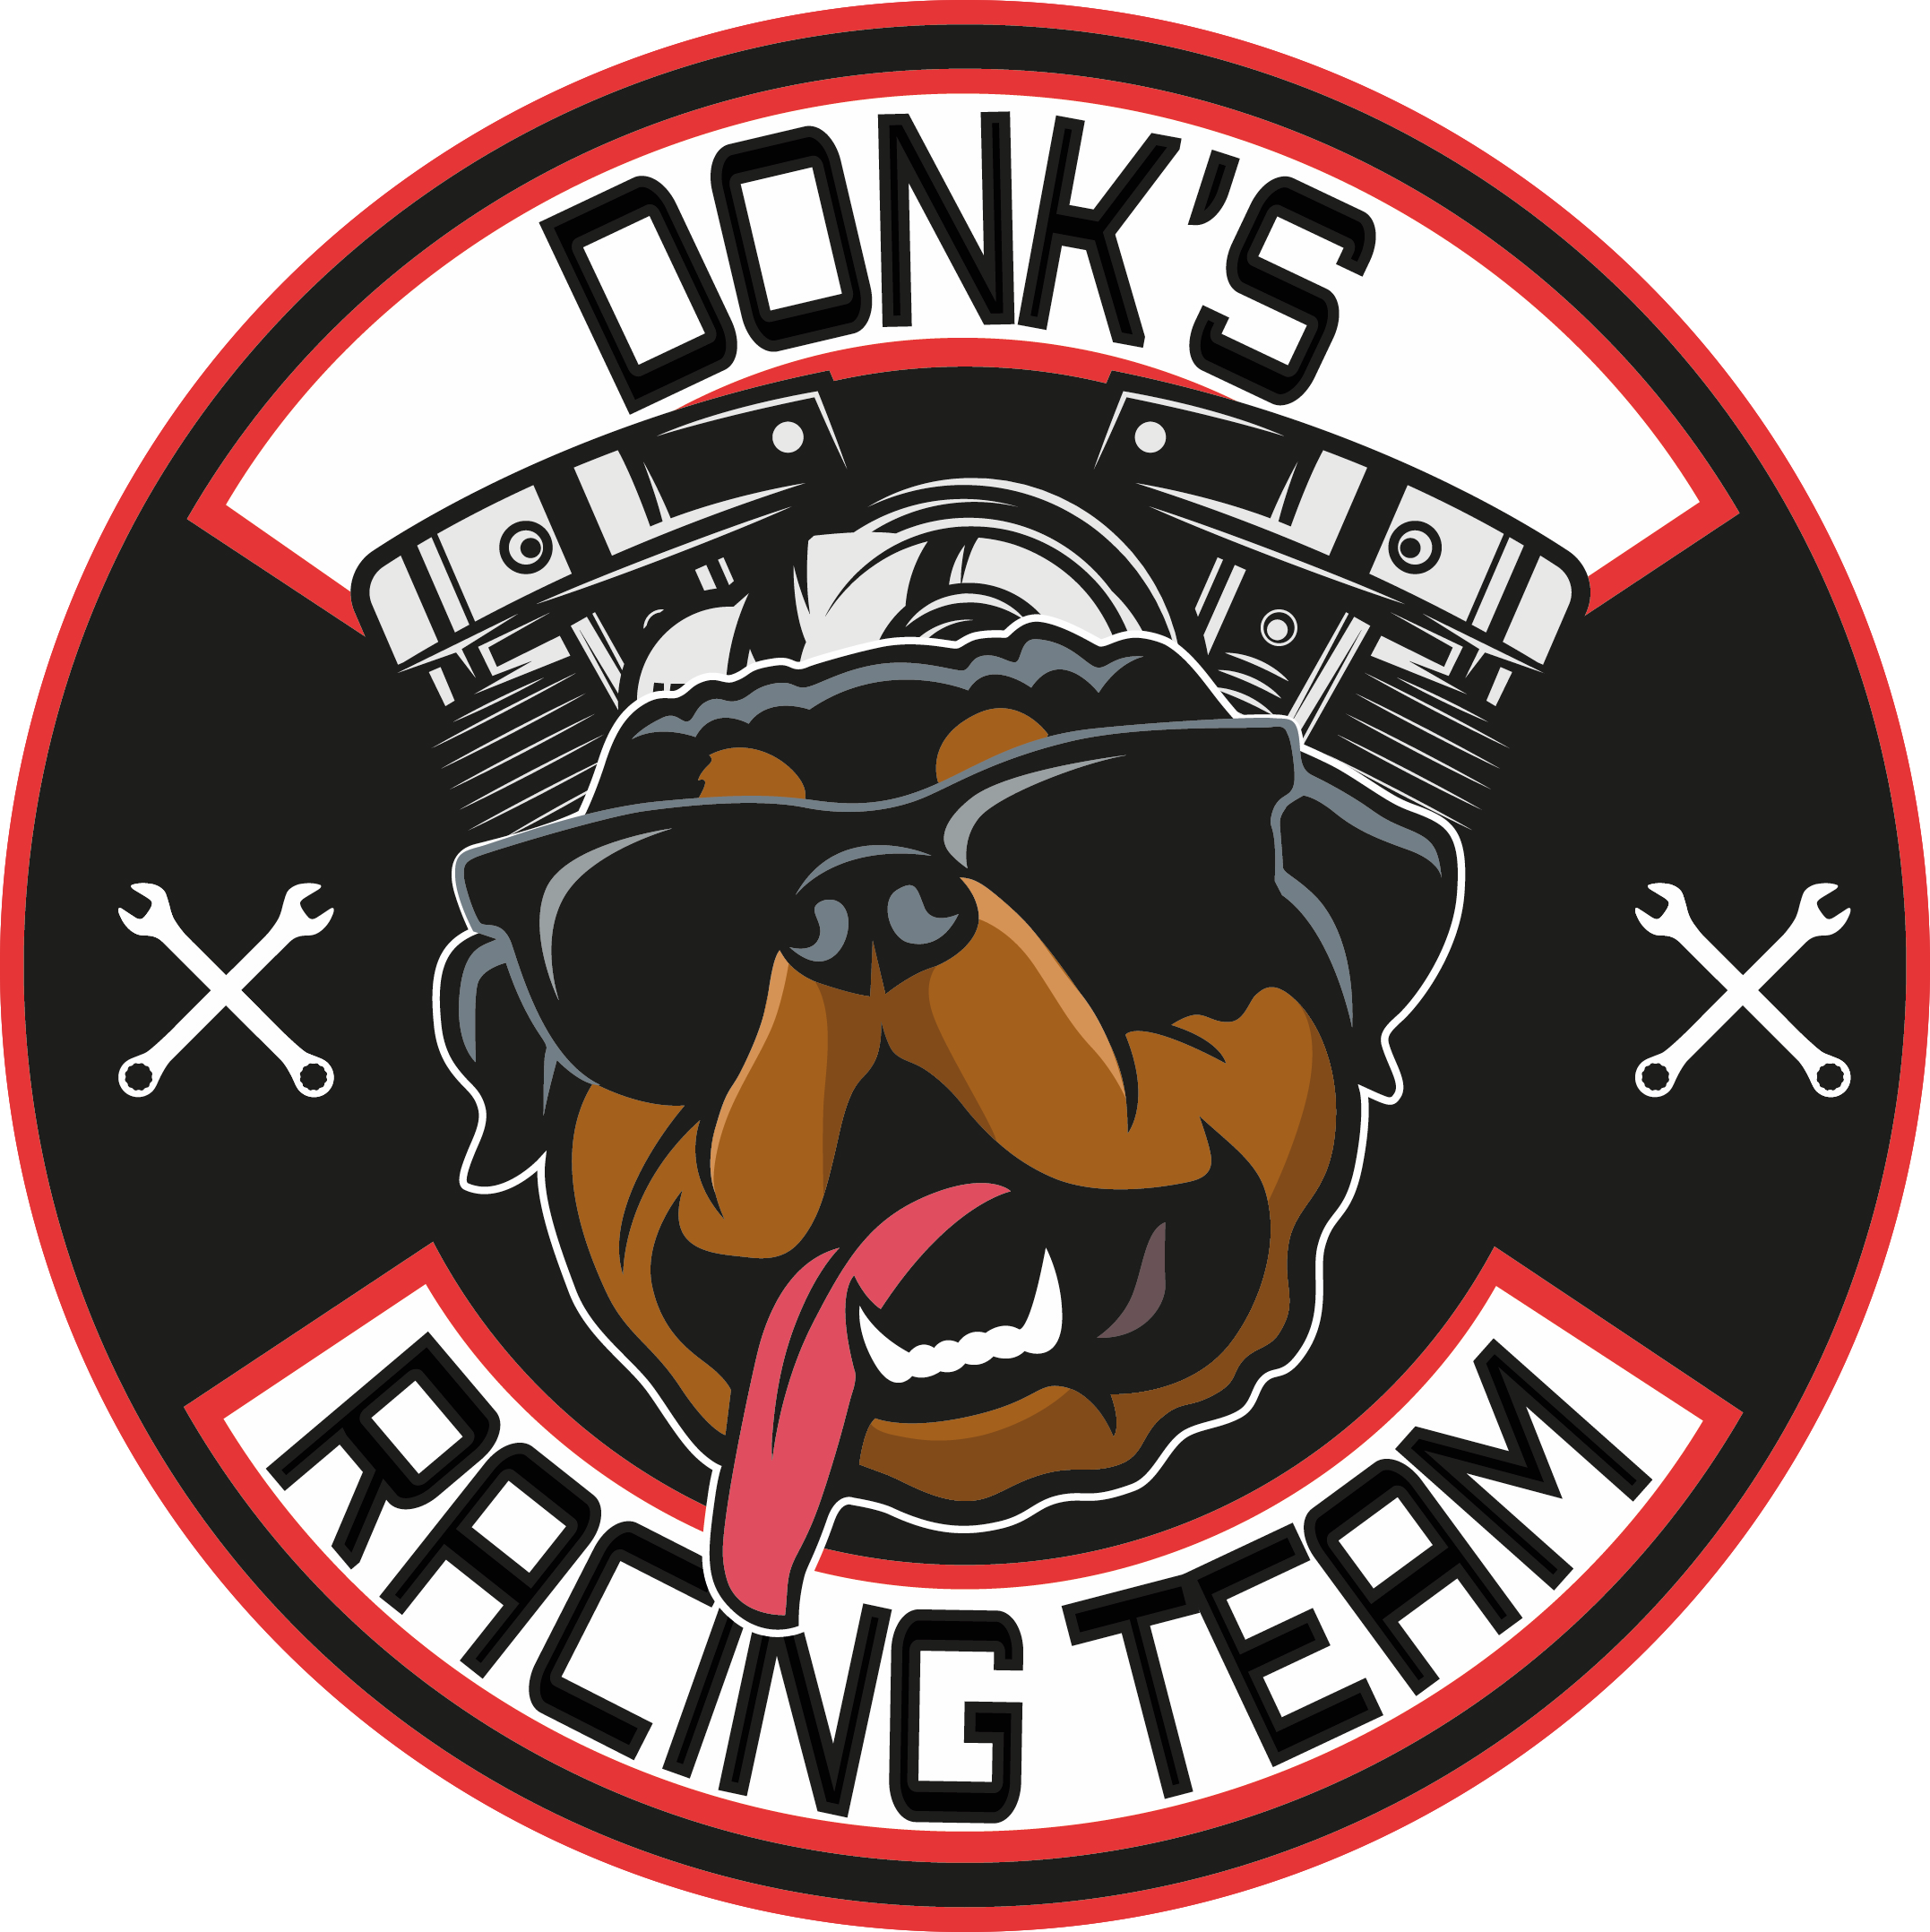
Team donk
Nitro V-Twin drag racing

Slide 2
Drag racing history
Drag racing became popular in the 1930s & 1940s with timed races being held in the dry lakes of southern California.
The first official drag strip was at santa ana in California, later known as the ‘santa ana drags’ it held the first commercial drag race on July 2nd 1950.
The worlds largest sanctioning body ‘the national hotrod association’ or ‘NHRA’ was founded by wally parks and held its first race in Pomona California in April 1953.
The NHRA now boasts a 24 race professional tour across the USA, with attendances second only to NASCAR.
This Photo by Unknown Author is licensed under CC BY

Slide 3
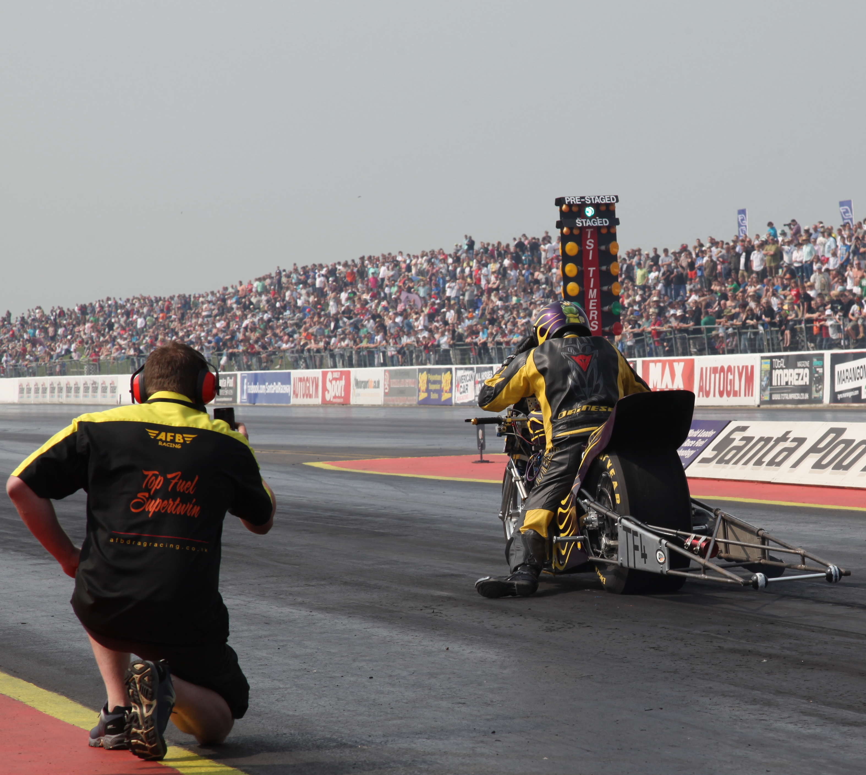
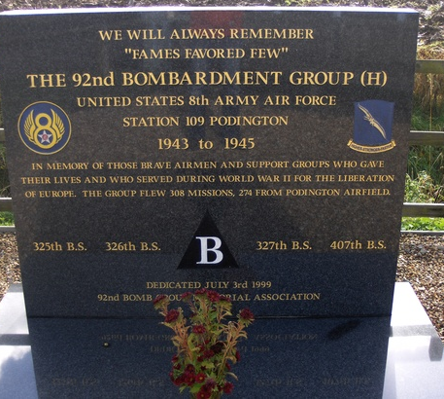
Uk drag racing
Santa pod raceway became the first official drag strip in the uk in 1966 and is still regarded as the premier drag race facility in Europe.
The word ‘santa’ pays homage to santa ana in southern California and ‘pod’ to reflect the local village of podington in Bedfordshire.
Podington Aerodrome was opened in 1942 to accommodate the United States Air Force, chiefly its 92nd Bombardment Group.
Competitiors from countries such as Sweden, Norway, Hungary, Germany, Malta and many others regularly travel to the two sanctioned FIA tour events held in the uk every year.

Slide 4
Drag racing classes
There are dozens of classes that run over ¼ mile, 1000ft and 1/8 mile tracks.
Top Fuel cars and bikes are seen as the premier vehicles in the sport, running on nitromethane (nitro), or just ‘fuel’ as it’s largely known to the racers.
Team Donk fits into the ‘top fuel super-twin’ bracket, running two cylinders instead of 4 in a traditional top fuel bike, or 8 in a top fuel dragster.

Slide 5
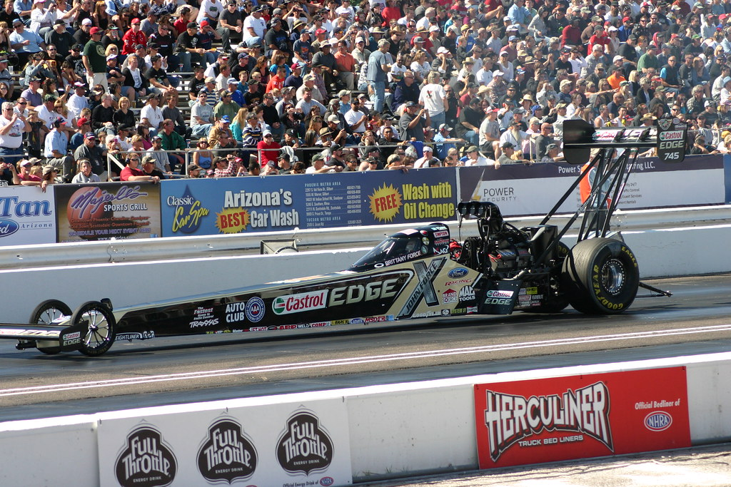
Top fuel dragster
Seen as the top of the tree in drag racing, estimated to produce in the region of 12,000 bhp.
500 cubic inch supercharged V8 hemi, made from billet aluminum.
1.2 - 1.5 gallons of nitro consumed per second under power.
0-100 mph in 0.7- 0.8 seconds.
Current world record elapsed time (1000ft) – 3.62 seconds (Sept 2019).
Current world record speed (1000ft) – 338.94mph (Nov 2022).
This Photo by Unknown Author is licensed under CC BY-NC-ND

Slide 6
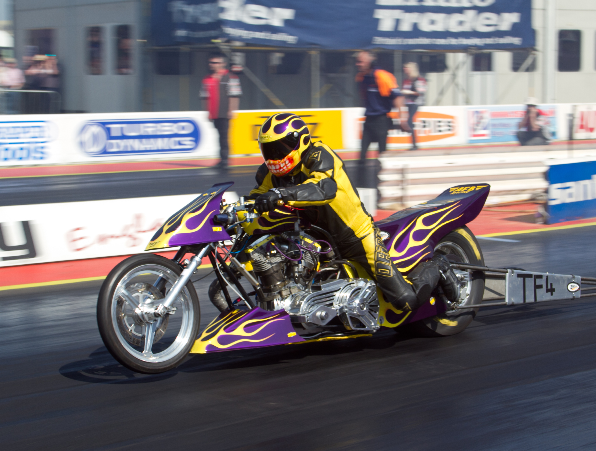
Top fuel super-twin
Many variations of twin cylinder engine, from 45 up to 90 degree angle V-twins with parallel twin combinations beginning to emerge.
Up to 3200cc (198ci) naturally aspirated combinations alongside up to 2000cc (183ci) supercharged power plants fueled by nitromethane.
Estimated horsepower around 1000bhp using up to 99% nitro and 1% methanol.
Current world record* (1/4 mile) elapsed time – 5.99 seconds (may 2022)
Current world record *(1/4 mile) speed – 237.75 MPH (Feb 2020)

Slide 7
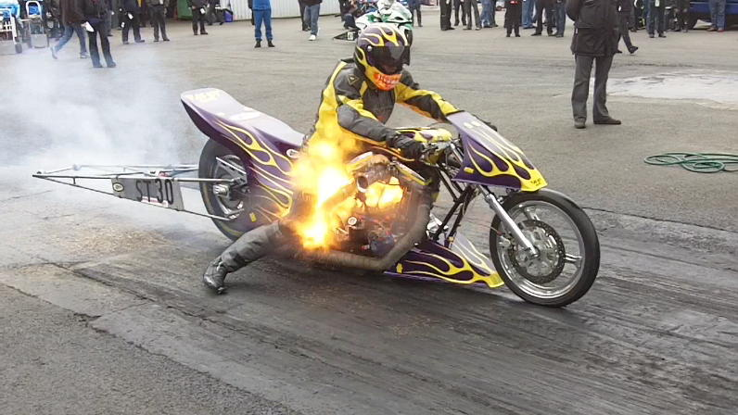
Nitro is not your friend!
An engine burning nitro can produce up to 2.4 times more power than burning petrol, partly due to nitro containing oxygen within its molecular structure.
Regular petrol requires approx. 14.7kgs of air (containing 21% oxygen) to burn 1kg of fuel. Nitro can burn 1kg of fuel with just 1.7kgs of air, allowing up to 7.6 times more fuel to be burned, thus vesting increasing power output.
Nitro engines require considerable adjustment for every ¼ mile run to adapt to track and atmospheric conditions. Adjustments include timing curve, clutch weight, clutch application, gear ratios, fuel percentage, fuel management.
To hold nitro in the uk, you must apply for an epp (explosive precursor & poisons license) due to the explosive mature of the fuel.
The chemical formula for nitromethane is CH₃NO₂

Slide 8
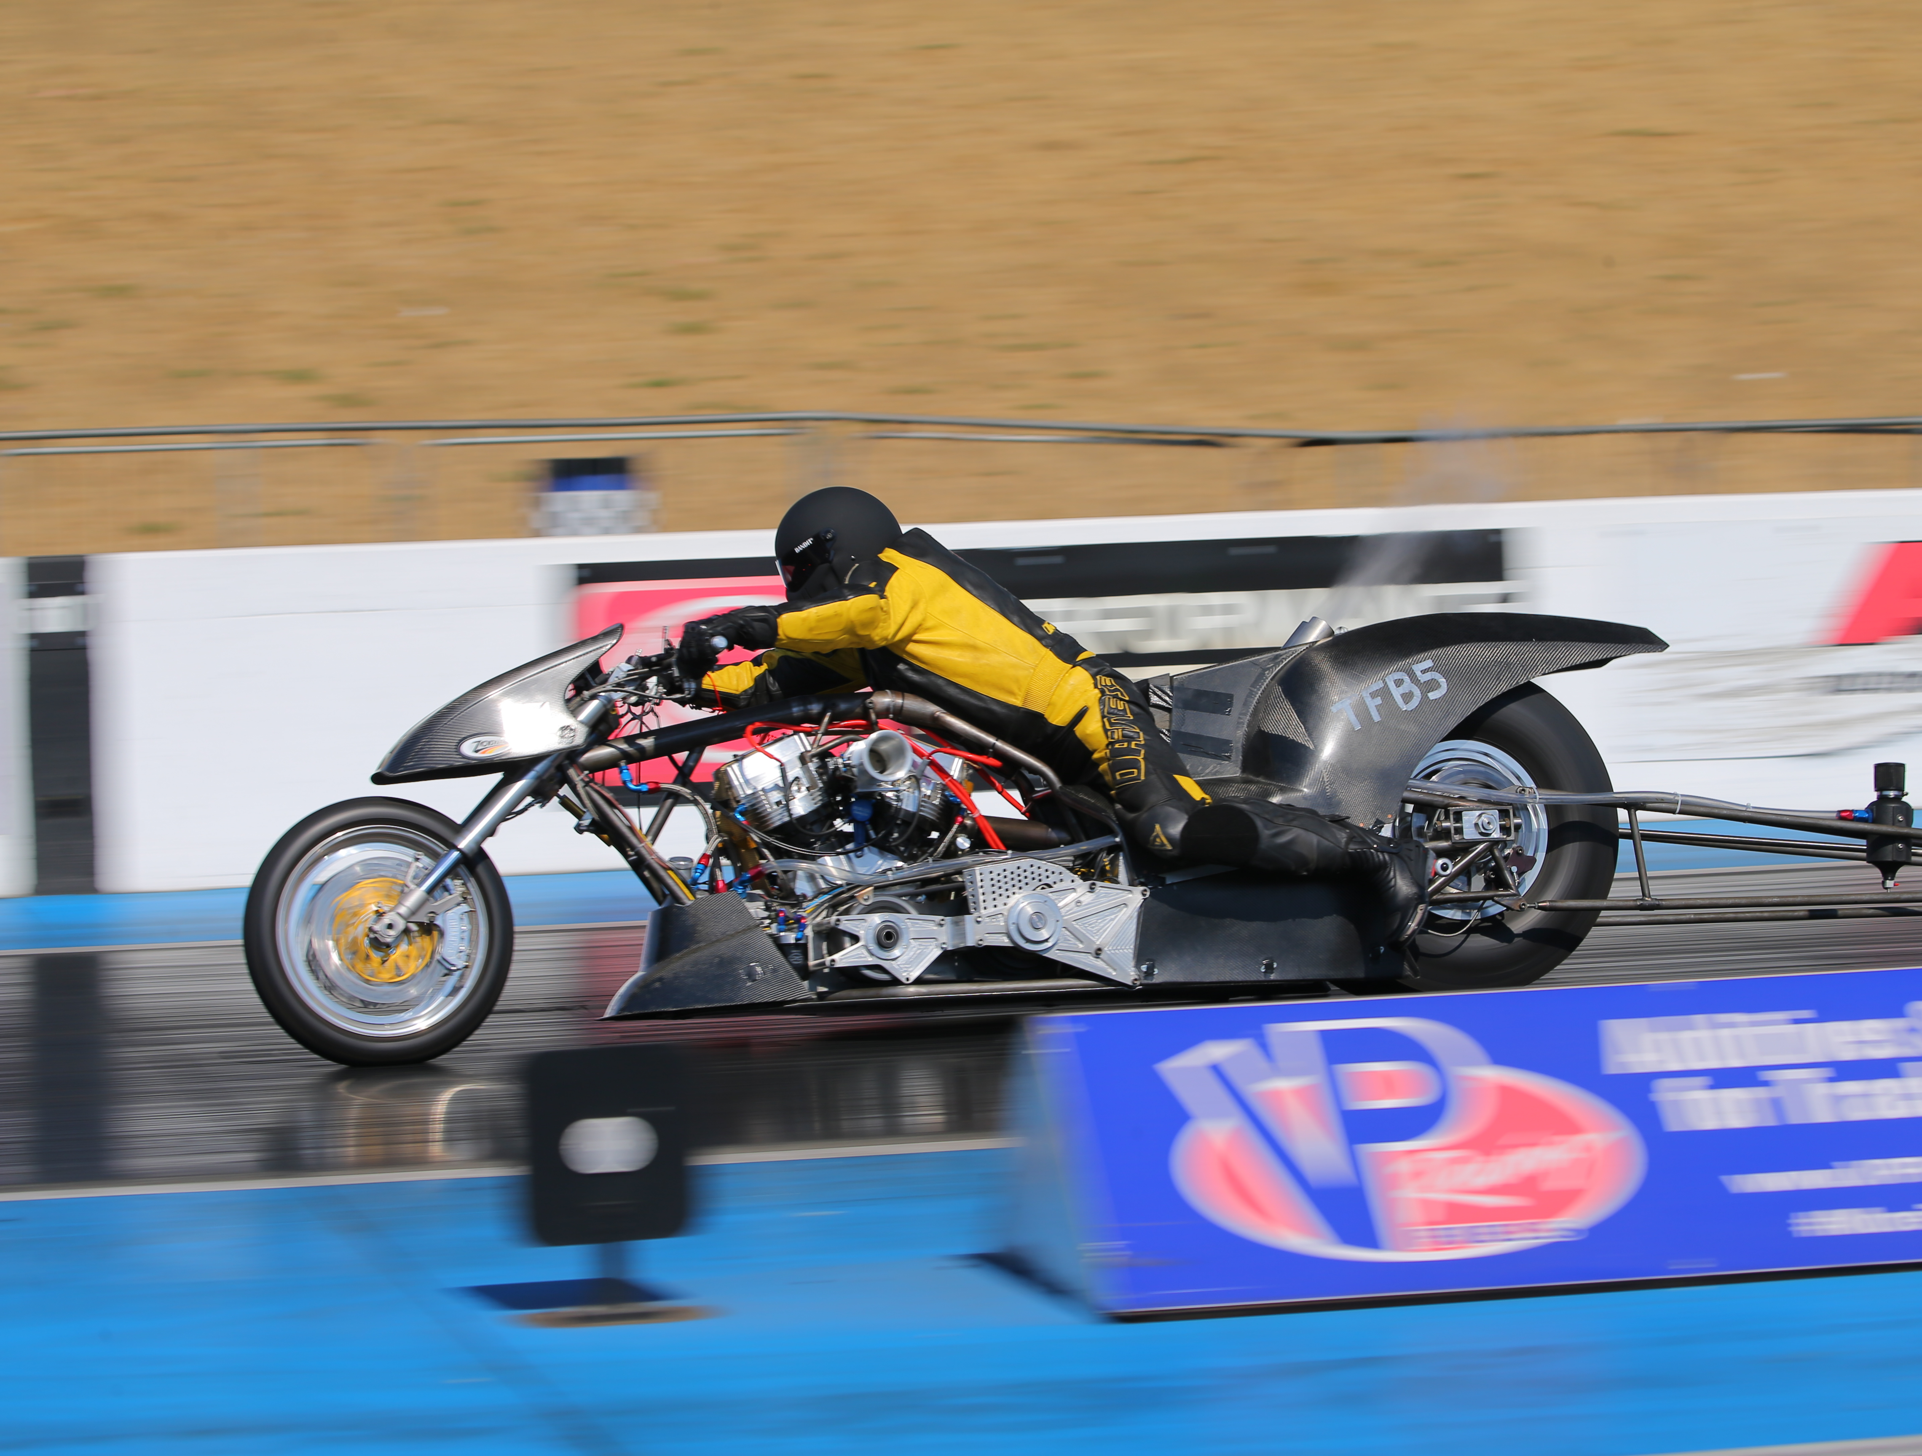
Donk Racing 2024 and beyond
New bike ready to complete testing October 2024 with a view to entering 2025 FIM European Drag Bike Championships.
196 cubic inch hawaya racing engine.
Bentec clutch with 5 inch primary belt and 2 speed owens gearbox.
Bespoke chromoly chassis designed and engineered by al smith engineering.
Crew Chief & Tuner: Frank Brachvogel.
Rider: Shawn Rodman.
Lead Mechanic: Ashley Burcombe.
Crew: Ben Mace, Nick Saunders & Karen Watson.

Slide 9
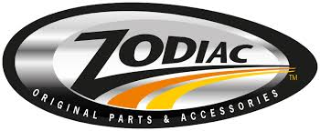
Thank you to our loyal sponsors
J W Hinchliffe (Tanks) Ltd
Nationwide fuel and oil tank services, including tank cleaning, decommissioning, inspection, installation and repair.
www.jwhtanks.co.uk
SDR Fabriactions LLP
Bespoke design, fabrication and installation of the highest quality steel, aluminum and stainless products.
www.sdrfabrications.co.uk
Zodiac International B.V
Designing, supplying and distributing the finest aftermarket parts for Harley Davidson motorcycles.
www.zodiac.nl
AFB Motorcycles
Somerset based Harley Davidson specialists, providing award winning custom bike builds, race parts, mot and servicing.
www.afbmotorcycles.co.uk
Sponsorship opportunities are available – speak to the team this evening or message nick via the facebook page.

Slide 10
Further info & references
Follow Donk’s Racing Team at facebook.com/nitrodonk
References
www.nhra.com
www.eurodragster.com
www.santapod.com
www.dragbike.com
www.rfmotorsports.com
*To set an official record prior to 2019, the time or speed was required to be ‘backed up’ by running within 1% of that time or speed during the same event. Therefore, some elapsed times or speeds achieved prior to 2019 may have been quicker or faster, but were not backed up.

